Slide 1
DBS501 Assignment 2 – HR Application Menu
Section: DBS501V1A.01102.2231 Mondays 6:30PM-9:30PM
By: Lisa Huynh and Brenda Yu

Slide 2
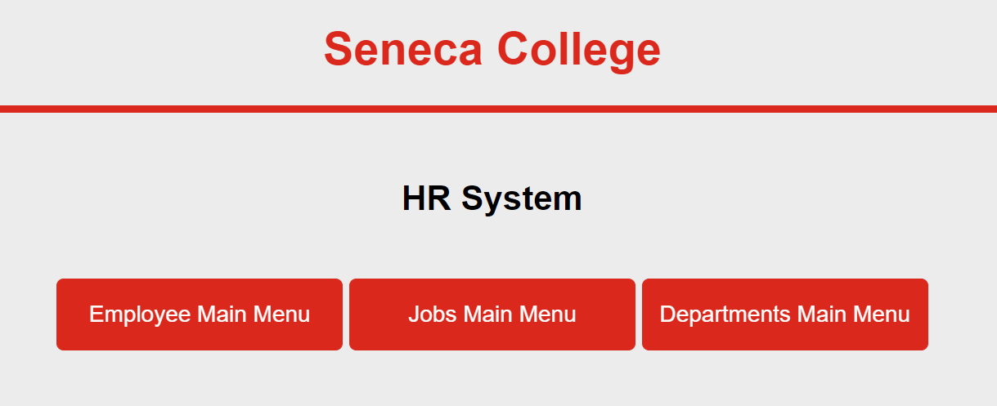
GUI - HR Application Menu

Slide 3
Task 1-1 Employee Hiring under Employee Main Menu

Slide 4
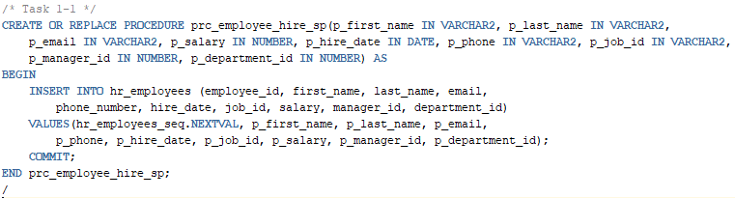
Employee_hire_sp Procedure

Slide 5
Task 1-2 GUI Work Employee Hiring under Employee Main Menu

Slide 6
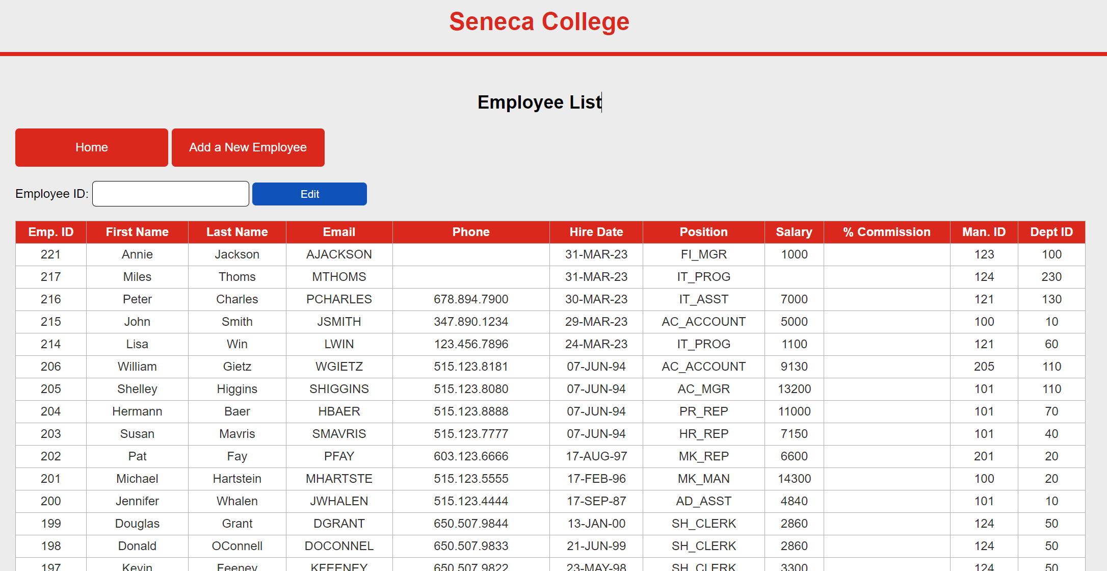
Employee List

Slide 7
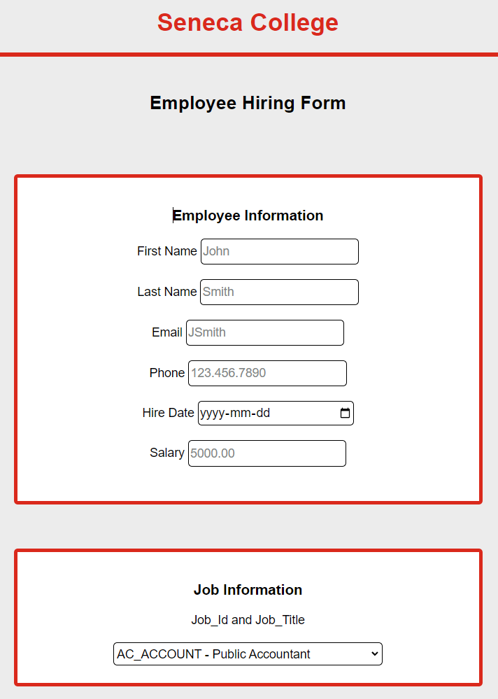
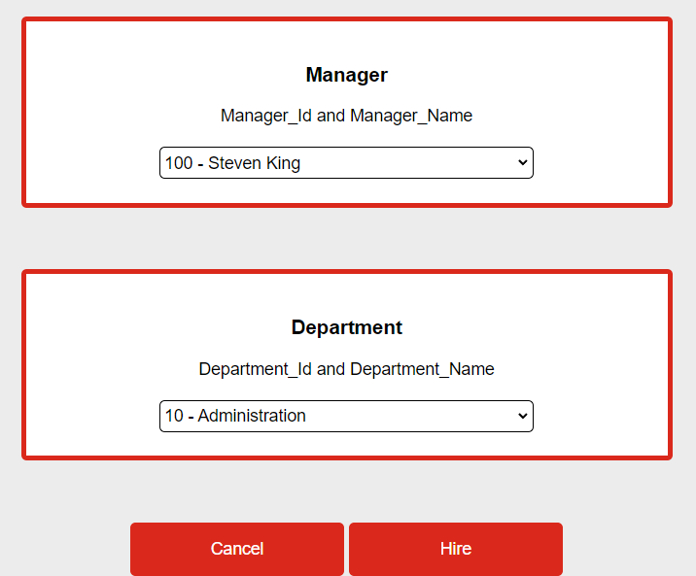
GUI - Employee Hiring Form

Slide 8
Task 1-3 Updating Employee Record

Slide 9
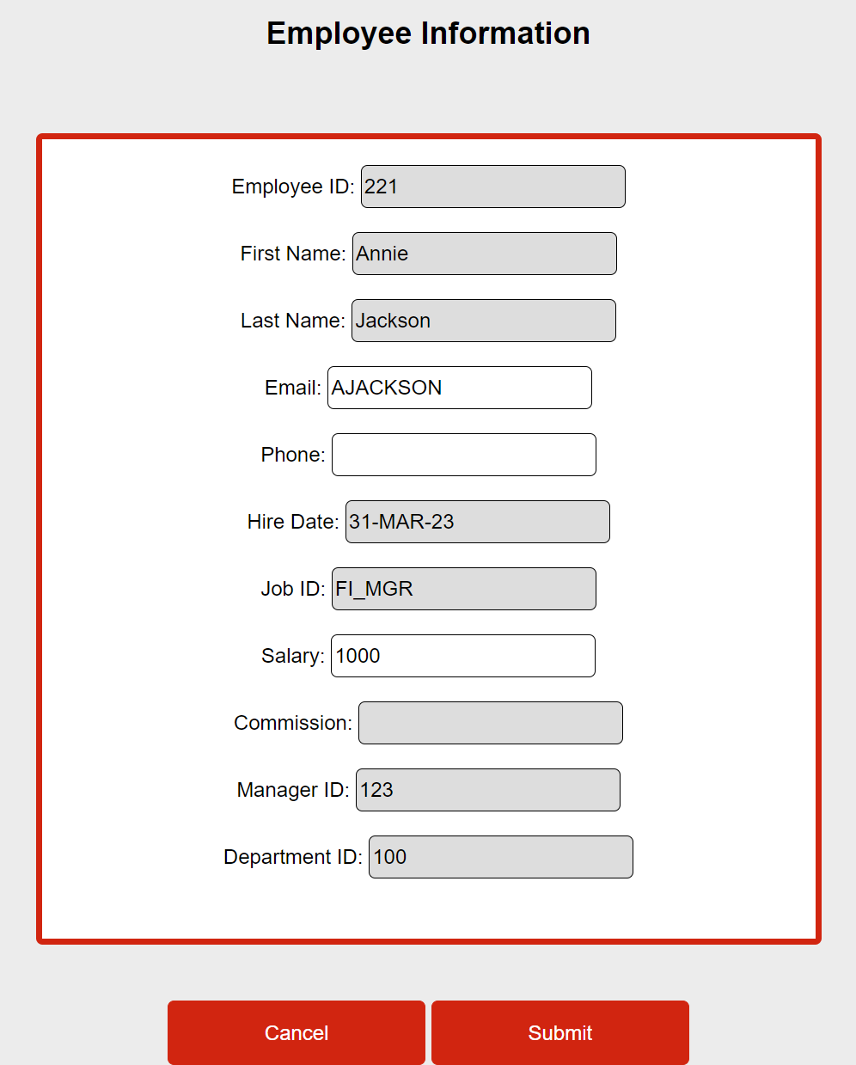
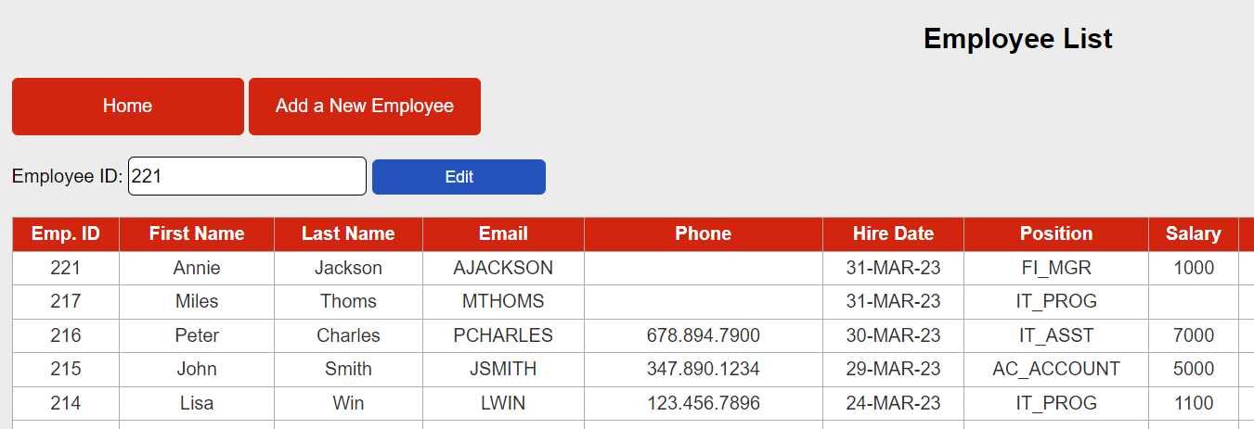
GUI - Edit Employee

Slide 10
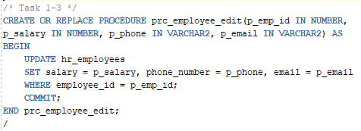
Procedure Employee Edit prc_employee_edit

Slide 11
Task 2-1 Identify Job Description

Slide 12
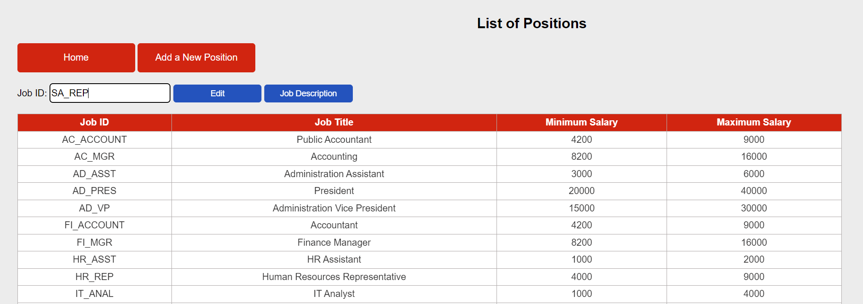
GUI - Identify Job Description

Slide 13
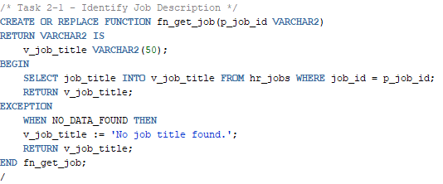
Function fn_get_job
Notes:
Wrote a function for SQL developer but for the front end, just used a SELECT statement to pull the job description.

Slide 14
Task 2-2 Allow End User to Change Job Description

Slide 15
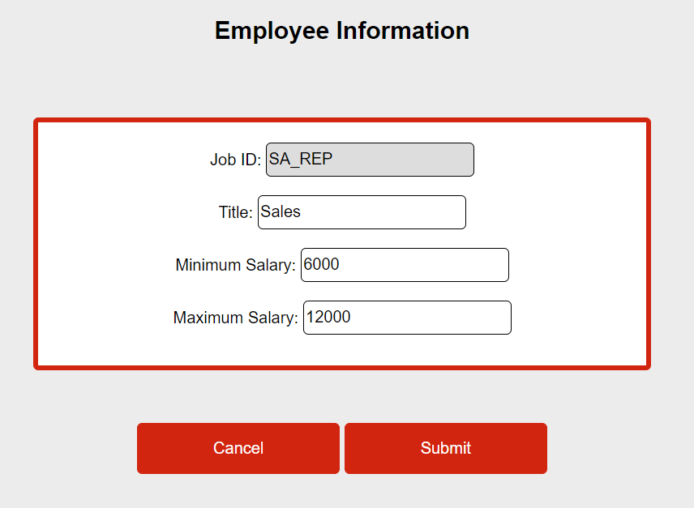
GUI - Allow User to Change Job Description
Notes:
If the user doesn’t enter a max salary, the SQL procedure will automatically set the max salary to min salary * 2

Slide 16
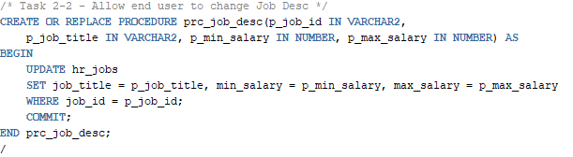
Procedure prc_job_desc

Slide 17
Task 2-3 Create a New Job

Slide 18
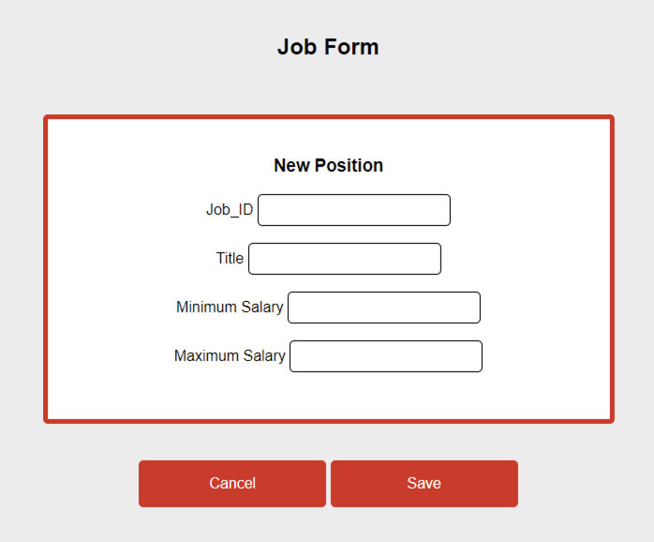
GUI - Create a New Job

Slide 19
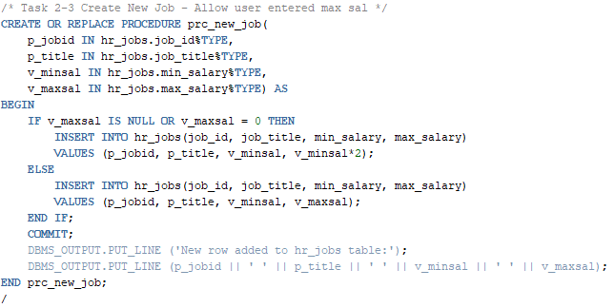
Procedure prc_new_job

Slide 20
Task 3 – Triggers - Check Job Minimum and Maximum Salary Range

Slide 21
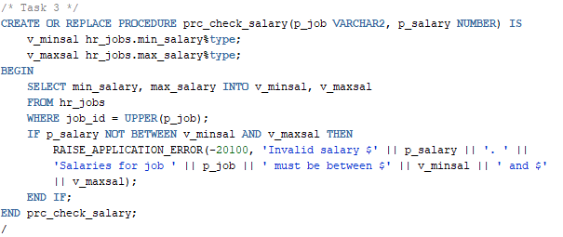
Procedure prc_check_salary

Slide 22
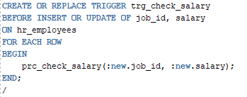
Trigger trg_check_salary

Slide 23
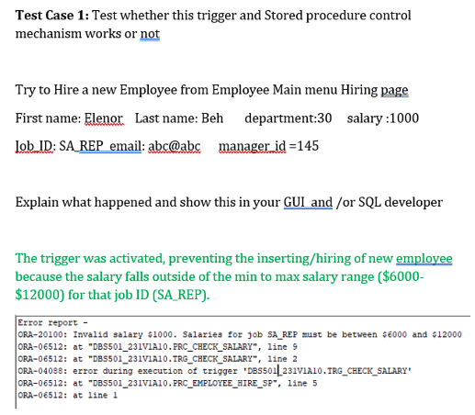
Test Case 1

Slide 24
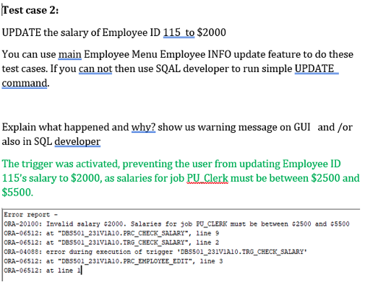
Test Case 2

Slide 25
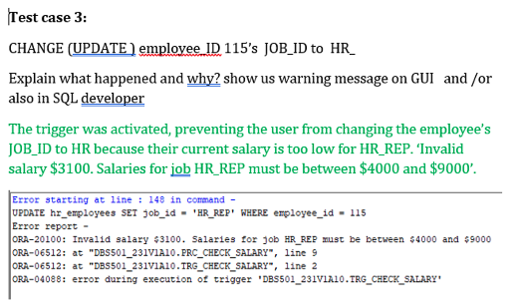
Test Case 3

